Slide 1


Welcome To Green University of Bangladesh A Higher Education Center of Excellence

Slide 2
GREEN UNIVERSITY OF BANGLADESH
Lecture - 1 Data Structures

Slide 3
Data Type and Data Structure
GREEN UNIVERSITY OF BANGLADESH
Data type
Set of possible values for variables
Operations on those values
Ex : int, float, char ……….
Data Structure
A data structure is an arrangement of data in a computer's memory or even disk storage.
The logical and mathematical model of a particular organization of data is called a data structure.
A data structure is a particular way of storing and organizing data in a computer so that it can be used efficiently.

Slide 4
GREEN UNIVERSITY OF BANGLADESH
Example of several common data structures:
Arrays,
Linked lists,
Stacks,
Queues,
Trees,
Graph

Slide 5
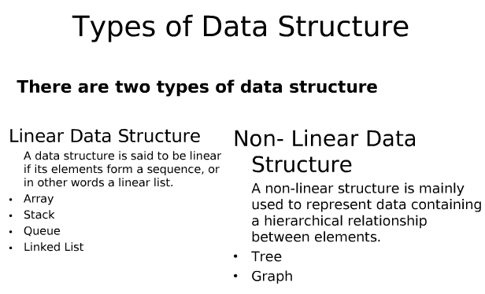
GREEN UNIVERSITY OF BANGLADESH

Slide 6
Array
GREEN UNIVERSITY OF BANGLADESH
Linear array (One dimensional array) : A list of finite number n of similar data elements
a set of n consecutive numbers, usually 1, 2, 3,…..n. That is a specific element is accessed by an index.
Let, Array name is A then the elements of A is : a₁,a₂….. a_{n}
Or by the bracket notation A[1], A[2], A[3],…………., A[n]
The number k in A[k] is called a subscript and A[k] is called a subscripted variable.
Homogeneous collection of values (all the same type)
Store values sequentially in memory
Associated INDEX with each value
Use array name and index to quickly access ‘K’ th element

Slide 7
Example
GREEN UNIVERSITY OF BANGLADESH
A linear array STUDENT consisting of the student ID of six students
STUDENT_ID
1 2 3 4 5 6 | 15
 | 9
 | 18
 | 22
 | 10
 | 35
Here, STUDENT_ID[4] denote 22

Slide 8
Array (con…)
GREEN UNIVERSITY OF BANGLADESH
Linear arrays are called one dimensional arrays because each element in such an array is referenced by one subscript.
(Two dimensional array) : Two dimensional array is a collection of similar data elements where each element is referenced by two subscripts.
Such arrays are called matrices in mathematics and tables in business applications.
Multidimensional arrays are defined analogously
MATRICES
1 2 3 4
1
2
1 | 2 | 3 | 4
5 | 6 | 7 | 8
9 | 10 | 11 | 12
13 | 14 | 15 | 16
3
4
Here, MATRICES[2][3]= 7

Slide 9
Array Data Structure
It can hold multiple values of a single type.
Elements are referenced by the array name and an ordinal index.
Each element is a value
Indexing begins at zero.
The array forms a continuous list in memory.
The name of the array holds the address of the first array element.
We specify the array size at compile time, often with a named constant.
GREEN UNIVERSITY OF BANGLADESH

Slide 10
Linked lists
GREEN UNIVERSITY OF BANGLADESH
A linked list, or one way list, is a linear collection of data elements, called nodes, where the linear order is given by means of pointers.
Dynamically allocate space for each element as needed.
Node
Data
Next
In linked list
Each node of the list contains the data item and a pointer to the next node
Collection structure has a pointer to the list Start
Initially NULL
Start

Slide 11
Linked lists
GREEN UNIVERSITY OF BANGLADESH
Start
node
node
Data
Next
Data
Linked list with 2 nodes

Slide 12
Linked lists
GREEN UNIVERSITY OF BANGLADESH
INFO
LINK
1
2
3
4
5
6
7
8
A
M
G
N
O
5
2
7
4
0
START
START=3, INFO[3]=M
LINK[3]=2, INFO[2]=A
LINK[2]=5, INFO[5]=N
LINK[5]=4, INFO[4]=G
LINK[4]=7, INFO[7]=O
LINK[7]=0, NULL value, So the list has ended
3

Slide 13
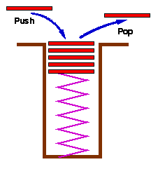
Stack
GREEN UNIVERSITY OF BANGLADESH
Stacks are a special form of collection with LIFO semantics
Two methods
- add item to the top of the stack
- remove an item from the top of the stack
Like a plate stacker

Slide 14
Queue
GREEN UNIVERSITY OF BANGLADESH
Like a stack, a queue is also a list. However, with a queue, insertion is done at one end, while deletion is performed at the other end
The insertion end is called rear
The deletion end is called front
Remove
Insert
front
rear

Slide 15
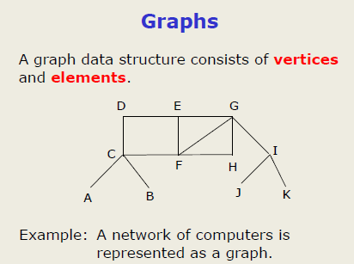
GREEN UNIVERSITY OF BANGLADESH
edges

Slide 16
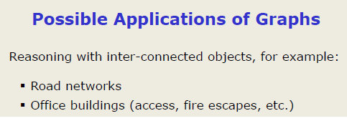
GREEN UNIVERSITY OF BANGLADESH

Slide 17
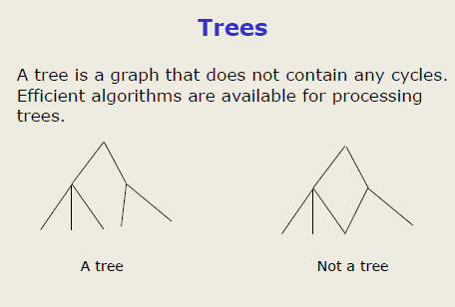
GREEN UNIVERSITY OF BANGLADESH

Slide 18
Data structure operations
GREEN UNIVERSITY OF BANGLADESH
The data appearing in our data structure is processed by means of certain operations. In fact, the particular data structure that one chooses for a given situation depends largely on the frequency with which specific operations are performed. The following four operations play a major role: Traversing Accessing each record exactly once so that certain items in the record may be processed. (This accessing or processing is sometimes called 'visiting" the records.) Searching Finding the location of the record with a given key value, or finding the locations of all records, which satisfy one or more conditions. Inserting Adding new records to the structure. Deleting Removing a record from the structure.

Slide 19
Data structure operations (Continued)
GREEN UNIVERSITY OF BANGLADESH
The following two operations, which are used in special situations, will also be considered:
Sorting:
Arranging the records in some logical order
Merging:
Combining the records in two different sorted files into a single sorted files

Slide 20
Algorithms
GREEN UNIVERSITY OF BANGLADESH
An essential aspect to data structures is algorithms. Data structures are implemented using algorithms.
An Algorithm is a finite step – by – step list of well defined instructions for solving a particular problem. It is used to manipulate the data contained in the data structures as in searching and sorting. It states explicitly how the data will be manipulated.

Slide 21
Algorithmic Notation
GREEN UNIVERSITY OF BANGLADESH
The format for the formal presentation of an algorithm consists of two parts. The first part is a paragraph which tells the purpose of the algorithm, identifies the variables which occur in the algorithm and lists the input data. The second part of the algorithm consists of the lists of steps that is to be executed.
Example : A nonempty array DATA with N numerical values is given. Find the location LOC and the value MAX of the largest element of DATA.
Algorithm 2.3: Given a nonempty array DATA with N numerical values, this algorithm finds the location LOC and the value MAX of the largest element of DATA.
Set K := 1, LOC := 1 and MAX := DATA[1].
Repeat steps 3 and 4 while K <= N:
If MAX < DATA[K], then :
Set LOC := K and MAX := DATA[K].
[End of if structure]
Set K := K +1.
Write: LOC, MAX.
Exit.

Slide 22
Algorithmic Notation
GREEN UNIVERSITY OF BANGLADESH
Steps, Control, Exit :
The steps of the algorithm are executed one after the other, beginning with step 1. Control may be transferred to step n by Go to step n
If several statements appear in the same step, e. g.
Set K : = 1, LOC : =1 and MAX : =DATA[1].
Then they are executed from left to right.
The algorithm is completed when the statement “Exit” Is encountered.
Comments :
Step may contain a comment in brackets which indicates the main purpose of the step.

Slide 23
Algorithmic Notation
Variable names:
Will use capital letters, as in MAX and DATA
Counters and subscripts will also be capitalized (K, N)
Assignment Statement:
Will use the dots-equal notation “:=“ MAX := DATA[1]
Assigns the value of DATA[1] to MAX.
(Will use the equal notation “=“ for compare)
Input and Output:
Data may be input and assigned to variables by means of a read statement
Read : Variable names.
Messages placed in quotation marks and Data in variables may be output by Write or print statement.
Write : Messages and/ or Variable names.
GREEN UNIVERSITY OF BANGLADESH

Slide 24
Algorithmic Notation
GREEN UNIVERSITY OF BANGLADESH
Procedures :
Independent algorithmic module which solves a particular problem. (We already know it as function)
Certain type of sub algorithm.

Slide 25
Complexity
GREEN UNIVERSITY OF BANGLADESH
The complexity of an algorithm is a function describing the efficiency of the algorithm in terms of the amount of data the algorithm must process. There are two main complexity measures of the efficiency of an algorithm:
Time complexity is a function describing the amount of time an algorithm takes in terms of the amount of input to the algorithm.
Space complexity is a function describing the amount of memory (space) an algorithm takes in terms of the amount of input to the algorithm.

Slide 26
Complexity of Algorithm
GREEN UNIVERSITY OF BANGLADESH
Suppose M is an algorithm, n size of the input data. The time and space used by the algorithm M are the two main measures for the efficiency of M.
The time is measured by counting the number of key operations – in sorting and searching algorithms, for example the number of comparisons.
The space is measured by counting the maximum of memory needed by the algorithm.
The complexity of an algorithm M is the function f(n) which gives the running time or storage space requirement of the algorithm in terms of the size n of the input data. Frequently, the storage space required by an algorithm is simply a multiple of the data size N.

Slide 27
Complexity of Algorithm
GREEN UNIVERSITY OF BANGLADESH
The two cases one usually investigates in complexity theory are as follows :
Worst case: The maximum value of f(n) for any possible input.
Average case: The expected value of f(n).
Sometimes we also consider the minimum possible value of f(n), called the best case.
Average case assumes a certain probabilistic distribution for the input data.
Suppose the numbers n₁, n₂,………,n_{k} occur with respective probabilities p₁, p₂, . . . p_{k} .Then the average value E is given by
E = n₁p₁ +n₂p₂+. . . . +n_{k}p_{k}.

Slide 28
Complexity of Algorithm
GREEN UNIVERSITY OF BANGLADESH
Example : Linear Search :
Algorithm 2.4 : A linear array DATA with N elements and a specific ITEM of information are given. This algorithm finds the location LOC of ITEM in the array DATA or sets LOC = 0.
Set K := 1, LOC := 0.
Repeat steps 3 and 4 while LOC = 0 and K<= N:
If ITEM = DATA[K], then : Set LOC := K .
Set K := K+1.
[End of step 2 loop]
[Successful?]
If LOC = 0, then :
Write : ITEM is not in the array DATA.
Else :
Write : LOC is the location of ITEM.
[End of if structure]
Exit.

Slide 29
Complexity of Algorithm
GREEN UNIVERSITY OF BANGLADESH
The complexity of the search algorithm is given by the number C comparisons between ITEM and DATA[k]. We seek C(n) for the worst case and the average case.
Worst case :
The worst case occurs when ITEM is the last element in the array or DATA is not there at all. In this situation, we have
C(n) = n
Accordingly C(n) is the worst case complexity of the linear search algorithm.
Average case :
The number of comparisons can be any of the numbers 1, 2, 3, . . . , n and each number occurs with probability p = 1/n. Then C(n) = 1 . 1/n + 2.1/n + . . . + n. 1/n =(1+2+. . .+n) .1/n
=(n(n+1)/2).1/n = (n+1)/2
The average number of comparisons needed to find the location of ITEM is approximately equal to half the number of elements in the DATA list.

Slide 30
GREEN UNIVERSITY OF BANGLADESH
Thank You

